Slide 1
PART V
Transport Layer

Slide 2
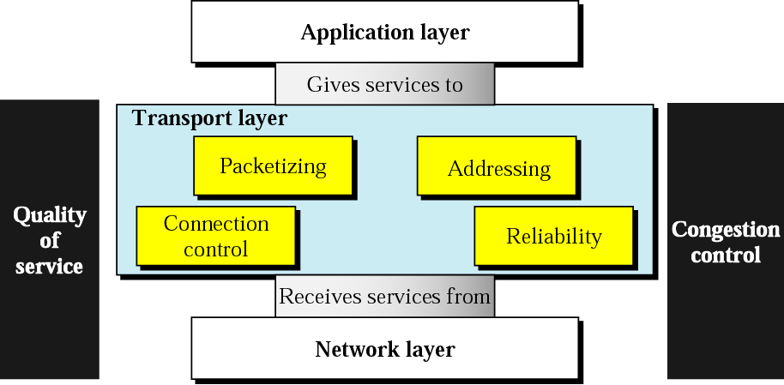
Position of transport layer

Slide 3
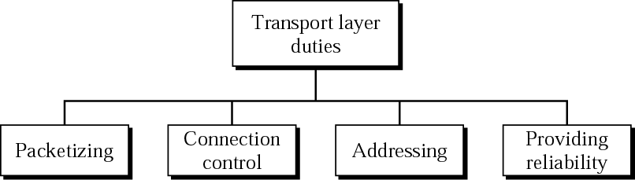
Transport layer duties

Slide 4
Chapters
Chapter 22 Process-to-Process Delivery
Chapter 23 Congestion Control and QoS

Slide 5
Chapter 22
Process-to-Process
Delivery:
UDP and TCP

Slide 6
22.1 Process-to-Process Delivery
Client-Server Paradigm
Addressing
Multiplexing and Demultiplexing
Connectionless/Connection-Oriented
Reliable/Unreliable

Slide 7

Note:
The transport layer is responsible for process-to-process delivery.

Slide 8
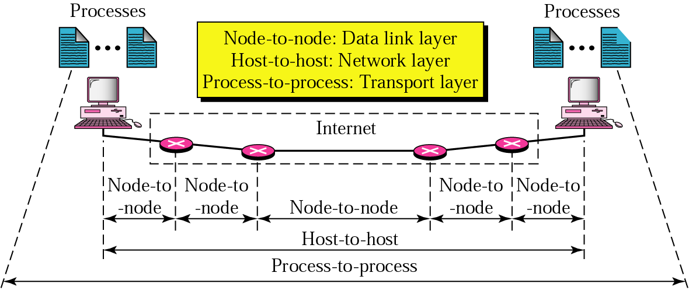
Figure 22.1 Types of data deliveries

Slide 9
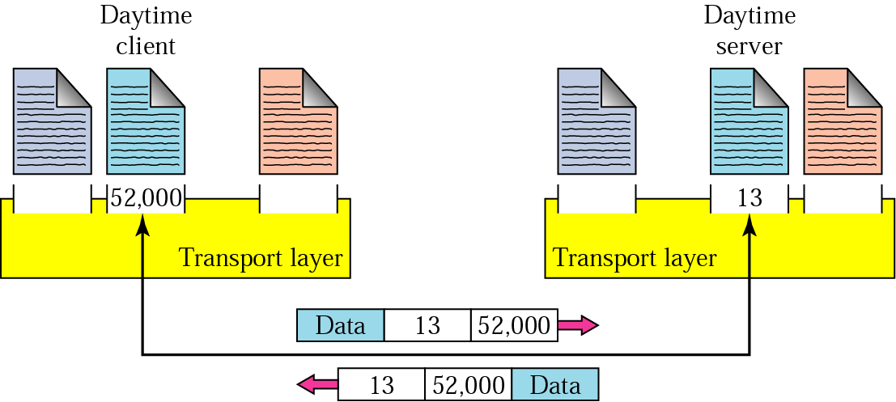
Figure 22.2 Port numbers

Slide 10
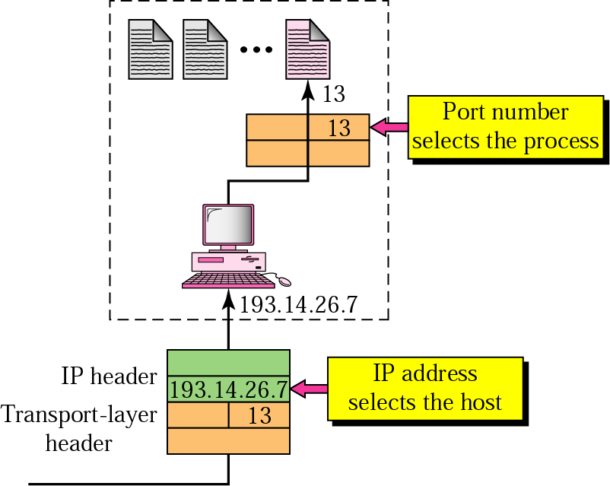
Figure 22.3 IP addresses versus port numbers

Slide 11
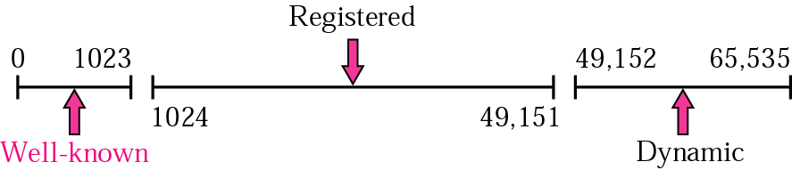
Figure 22.4 IANA ranges

Slide 12
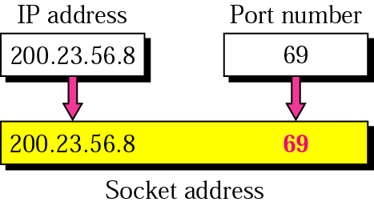
Figure 22.5 Socket address

Slide 13
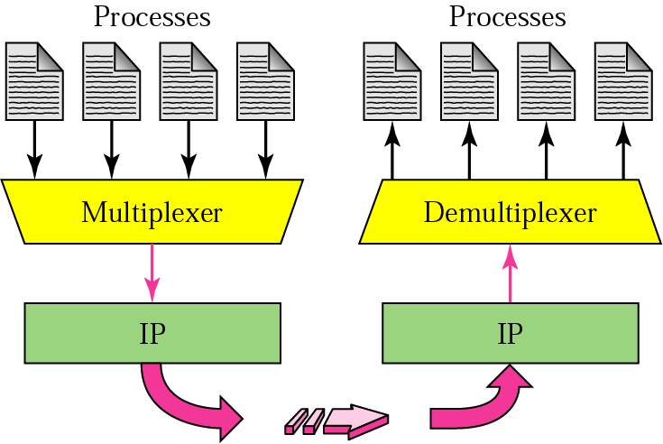
Figure 22.6 Multiplexing and demultiplexing

Slide 14
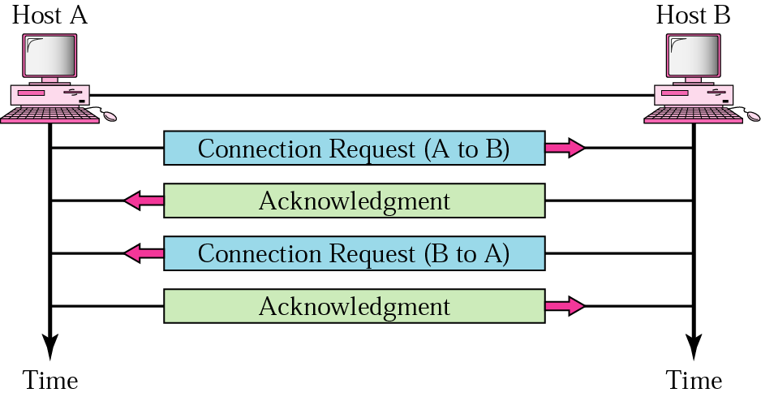
Figure 22.7 Connection establishment

Slide 15
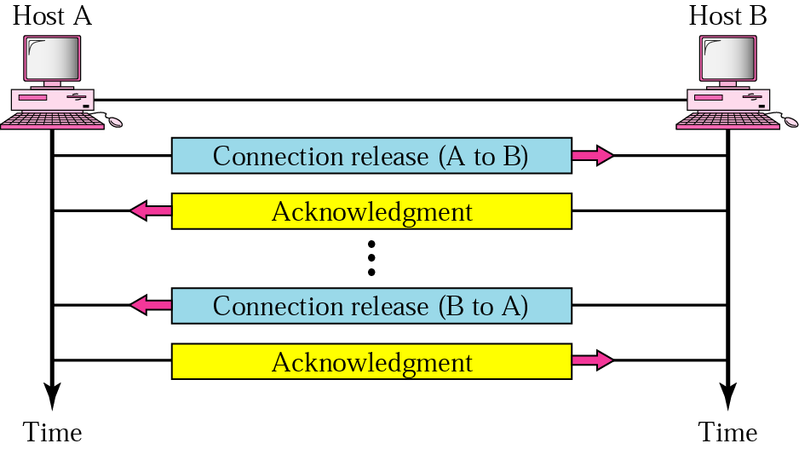
Figure 22.8 Connection termination

Slide 16
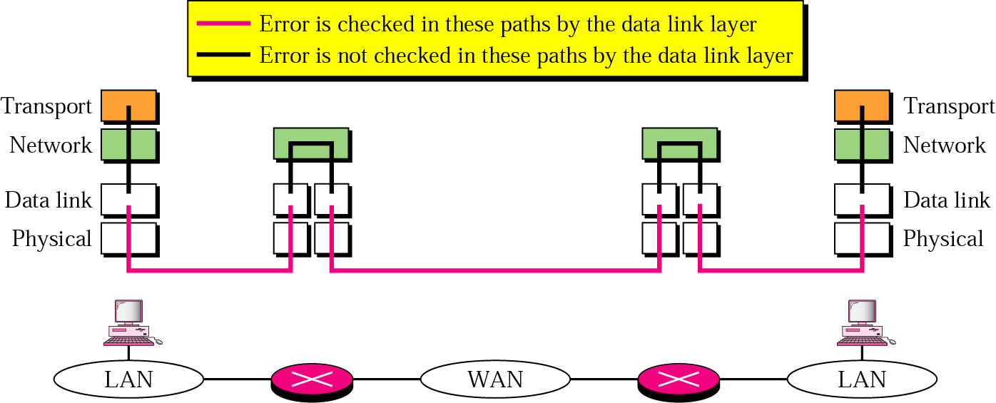
Figure 22.9 Error control

Slide 17
22.2 UDP
Port Numbers
User Datagram
Applications

Slide 18
Note:
UDP is a connectionless, unreliable protocol that has no flow and error control. It uses port numbers to multiplex data from the application layer.

Slide 19
Table 22.1 Well-known ports used by UDP
Port | Protocol | Description
7 | Echo | Echoes a received datagram back to the sender
9 | Discard | Discards any datagram that is received
11 | Users | Active users
13 | Daytime | Returns the date and the time
17 | Quote | Returns a quote of the day
19 | Chargen | Returns a string of characters
53 | Nameserver | Domain Name Service
67 | Bootps | Server port to download bootstrap information
68 | Bootpc | Client port to download bootstrap information
69 | TFTP | Trivial File Transfer Protocol
111 | RPC | Remote Procedure Call
123 | NTP | Network Time Protocol
161 | SNMP | Simple Network Management Protocol
162 | SNMP | Simple Network Management Protocol (trap)

Slide 20
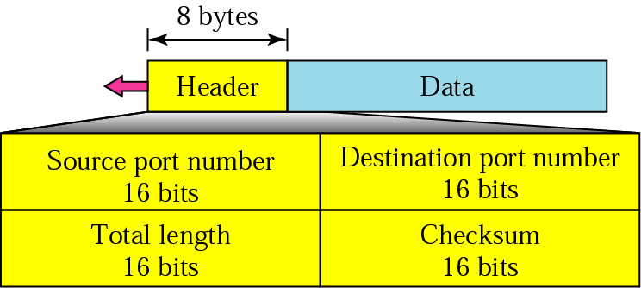
Figure 22.10 User datagram format

Slide 21
Note:
The calculation of checksum and its inclusion in the user datagram are optional.

Slide 22
Note:
UDP is a convenient transport-layer protocol for applications that provide flow and error control. It is also used by multimedia applications.

Slide 23
22.3 TCP
Port Numbers
Services
Sequence Numbers
Segments
Connection
Transition Diagram
Flow and Error Control
Silly Window Syndrome

Slide 24
Table 22.2 Well-known ports used by TCP
Port | Protocol | Description
7 | Echo | Echoes a received datagram back to the sender
9 | Discard | Discards any datagram that is received
11 | Users | Active users
13 | Daytime | Returns the date and the time
17 | Quote | Returns a quote of the day
19 | Chargen | Returns a string of characters
20 | FTP, Data | File Transfer Protocol (data connection)
21 | FTP, Control | File Transfer Protocol (control connection)
23 | TELNET | Terminal Network
25 | SMTP | Simple Mail Transfer Protocol
53 | DNS | Domain Name Server
67 | BOOTP | Bootstrap Protocol
79 | Finger | Finger
80 | HTTP | Hypertext Transfer Protocol
111 | RPC | Remote Procedure Call

Slide 25
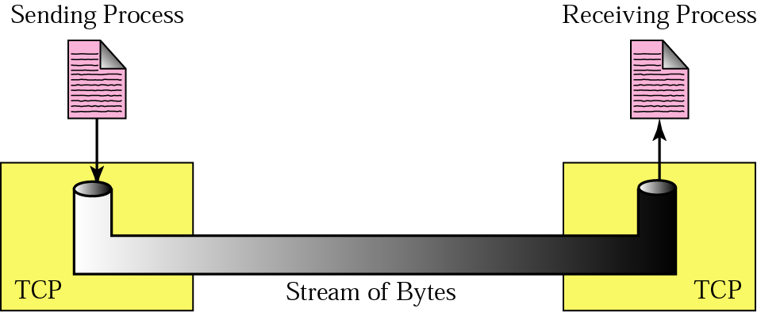
Figure 22.11 Stream delivery

Slide 26
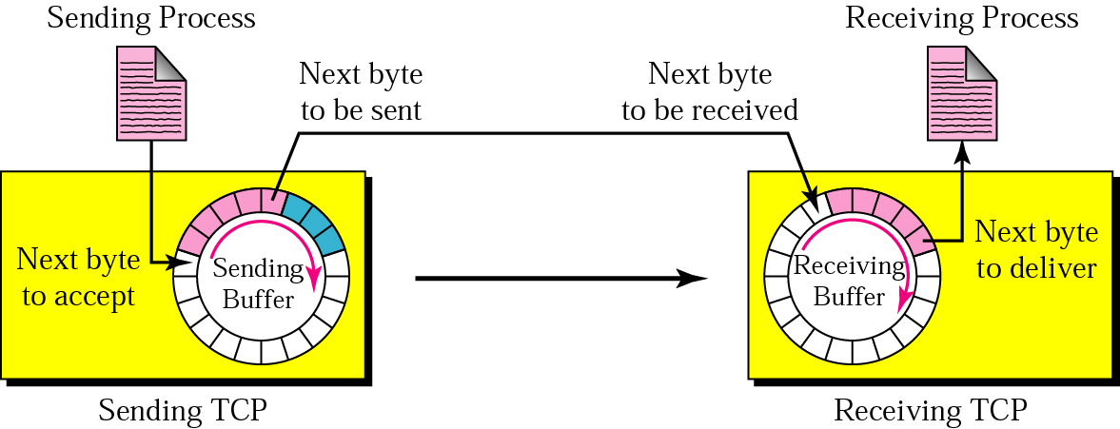
Figure 22.12 Sending and receiving buffers

Slide 27
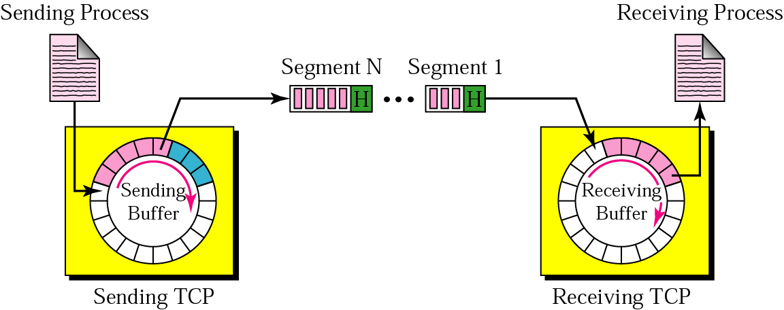
Figure 22.13 TCP segments

Slide 28
Example 1
Imagine a TCP connection is transferring a file of 6000 bytes. The first byte is numbered 10010. What are the sequence numbers for each segment if data are sent in five segments with the first four segments carrying 1000 bytes and the last segment carrying 2000 bytes?
Solution
The following shows the sequence number for each segment:
Segment 1 ==> sequence number: 10,010 (range: 10,010 to 11,009)
Segment 2 ==> sequence number: 11,010 (range: 11,010 to 12,009)
Segment 3 ==> sequence number: 12,010 (range: 12,010 to 13,009)
Segment 4 ==> sequence number: 13,010 (range: 13,010 to 14,009)
Segment 5 ==> sequence number: 14,010 (range: 14,010 to 16,009)

Slide 29
Note:
The bytes of data being transferred in each connection are numbered by TCP. The numbering starts with a randomly generated number.

Slide 30
Note:
The value of the sequence number field in a segment defines the number of the first data byte contained in that segment.

Slide 31
Note:
The value of the acknowledgment field in a segment defines the number of the next byte a party expects to receive.
The acknowledgment number is cumulative.

Slide 32
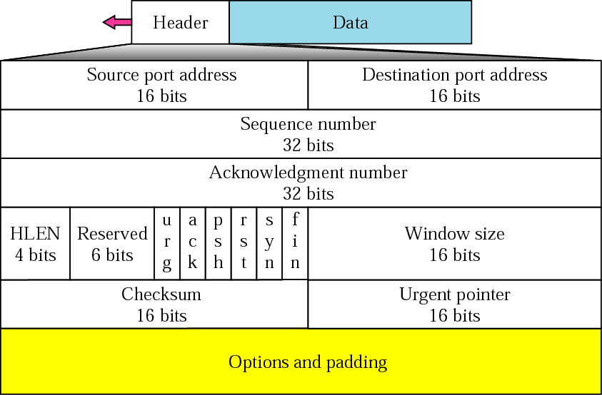
Figure 22.14 TCP segment format

Slide 33
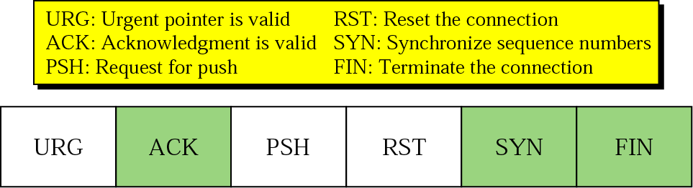
Figure 22.15 Control field

Slide 34
Table 22.3 Description of flags in the control field
Flag | Description
URG | The value of the urgent pointer field is valid.
ACK | The value of the acknowledgment field is valid.
PSH | Push the data.
RST | The connection must be reset.
SYN | Synchronize sequence numbers during connection.
FIN | Terminate the connection.

Slide 35
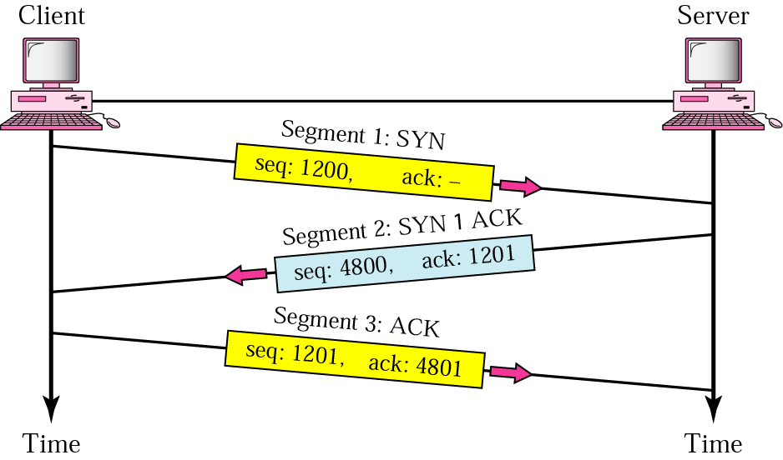
Figure 22.16 Three-step connection establishment

Slide 36
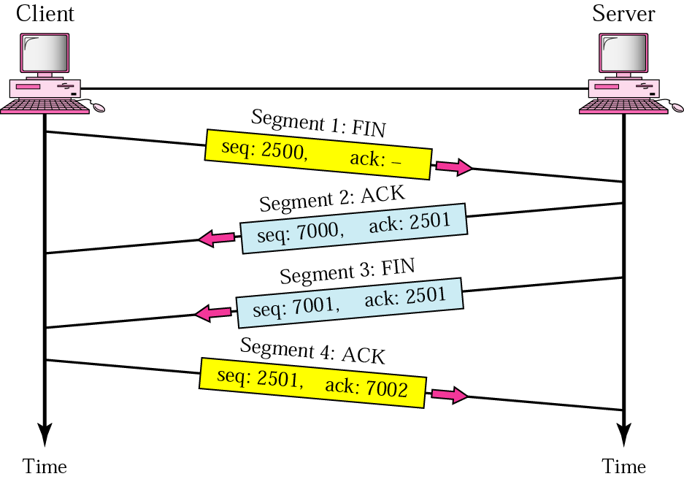
Figure 22.17 Four-step connection termination

Slide 37
Table 22.4 States for TCP
State | Description
CLOSED | There is no connection.
LISTEN | The server is waiting for calls from the client.
SYN-SENT | A connection request is sent; waiting for acknowledgment.
SYN-RCVD | A connection request is received.
ESTABLISHED | Connection is established.
FIN-WAIT-1 | The application has requested the closing of the connection.
FIN-WAIT-2 | The other side has accepted the closing of the connection.
TIME-WAIT | Waiting for retransmitted segments to die.
CLOSE-WAIT | The server is waiting for the application to close.
LAST-ACK | The server is waiting for the last acknowledgment.

Slide 38
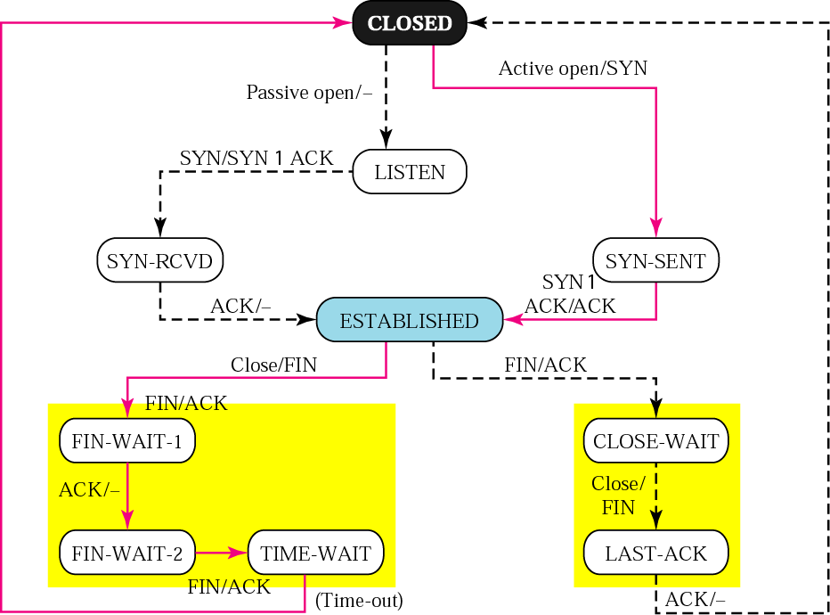
Figure 22.18 State transition diagram

Slide 39
Note:
A sliding window is used to make transmission more efficient as well as to control the flow of data so that the destination does not become overwhelmed with data. TCP’s sliding windows are byte-oriented.

Slide 40
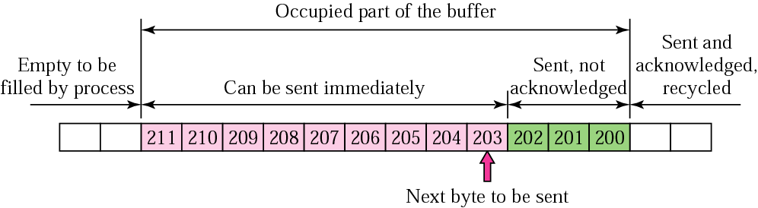
Figure 22.19 Sender buffer

Slide 41
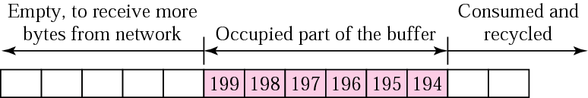
Figure 22.20 Receiver window

Slide 42
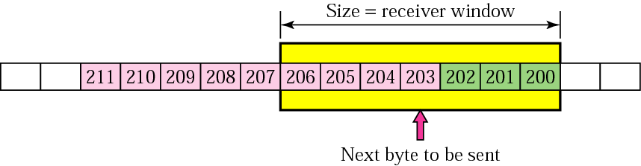
Figure 22.21 Sender buffer and sender window

Slide 43
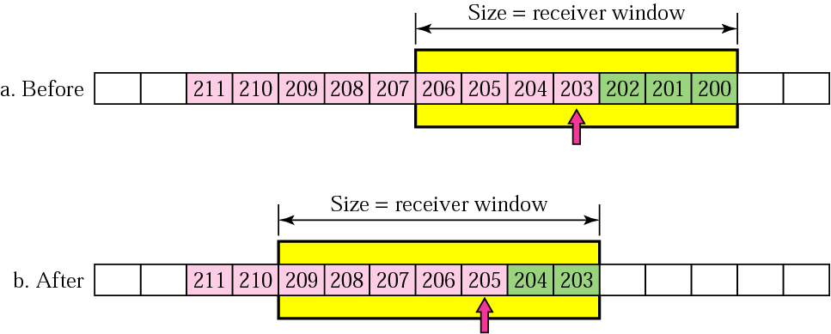
Figure 22.22 Sliding the sender window

Slide 44
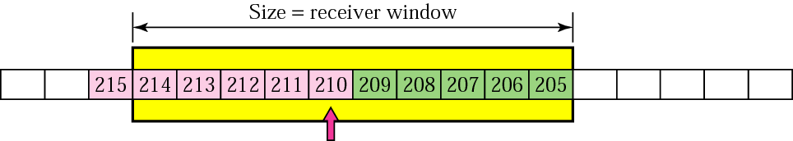
Figure 22.23 Expanding the sender window

Slide 45
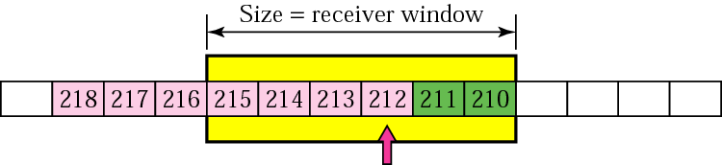
Figure 22.24 Shrinking the sender window

Slide 46
Note:
In TCP, the sender window size is totally controlled by the receiver window value (the number of empty locations in the receiver buffer). However, the actual window size can be smaller if there is congestion in the network.

Slide 47
Note:
Some points about TCP’s sliding windows:
The source does not have to send a full
window’s worth of data.
The size of the window can be increased or
decreased by the destination.
The destination can send an acknowledgment
at any time.

Slide 48
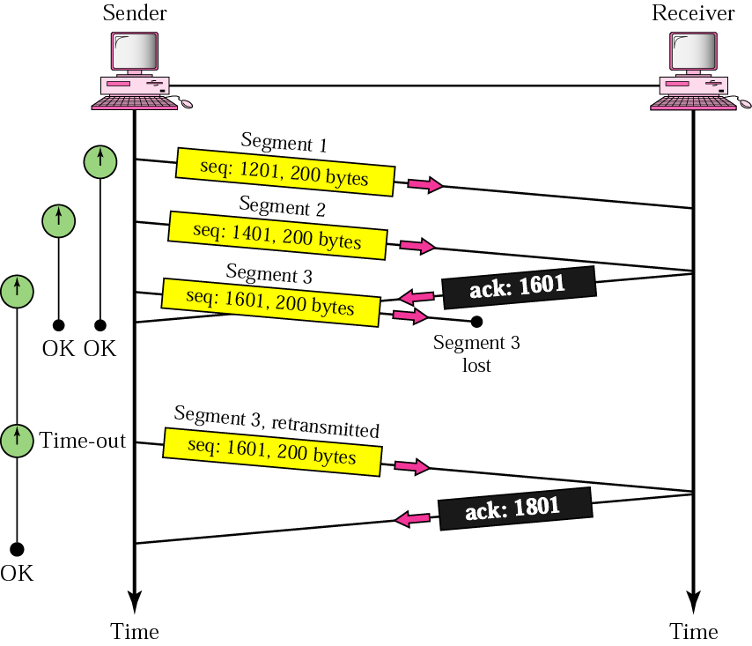
Figure 22.25 Lost segment

Slide 49
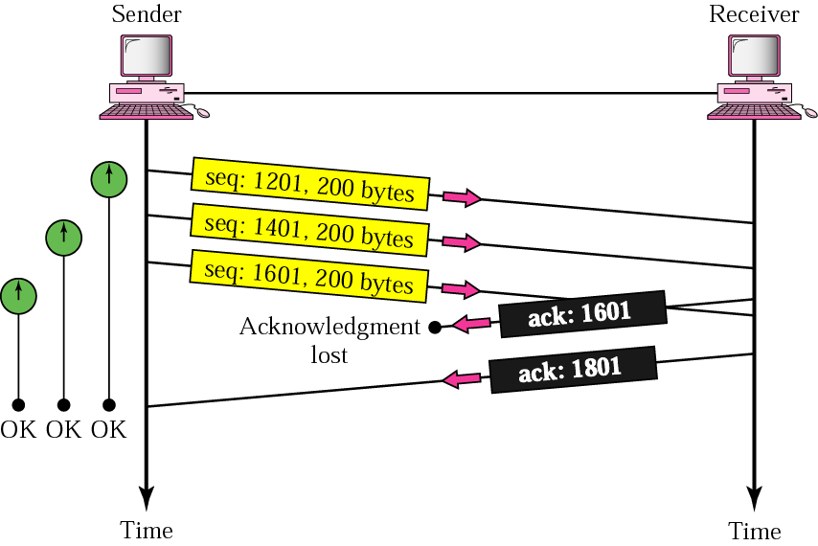
Figure 22.26 Lost acknowledgment

Slide 50
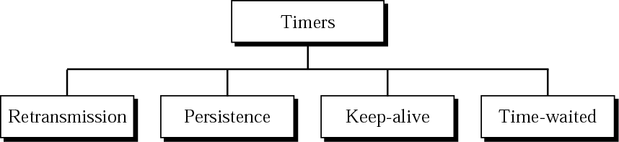
Figure 22.27 TCP timers

